Slide 1
Predicting Quality of Hospitals in the United States
Senait Abate

Slide 2
Can a hospital’s performance be predicted based on cost of care and qualitative ratings compared to the national average?

Slide 3
Main Data Features
3,715 hospitals
Rating: 1-5
Hospital ratings compared to the national average
1 =lowest, 2 =below average, 3 =average, 4 =above average, 5 =highest
Hospital/Facility Type
Private, Government, Proprietary, Church, Unknown
Average Cost of Care
Heart attack, heart failure, pneumonia, and hip and knee procedures
Cost of Care Rating
Value and quality for each procedure rated from 1 to 5

Slide 4
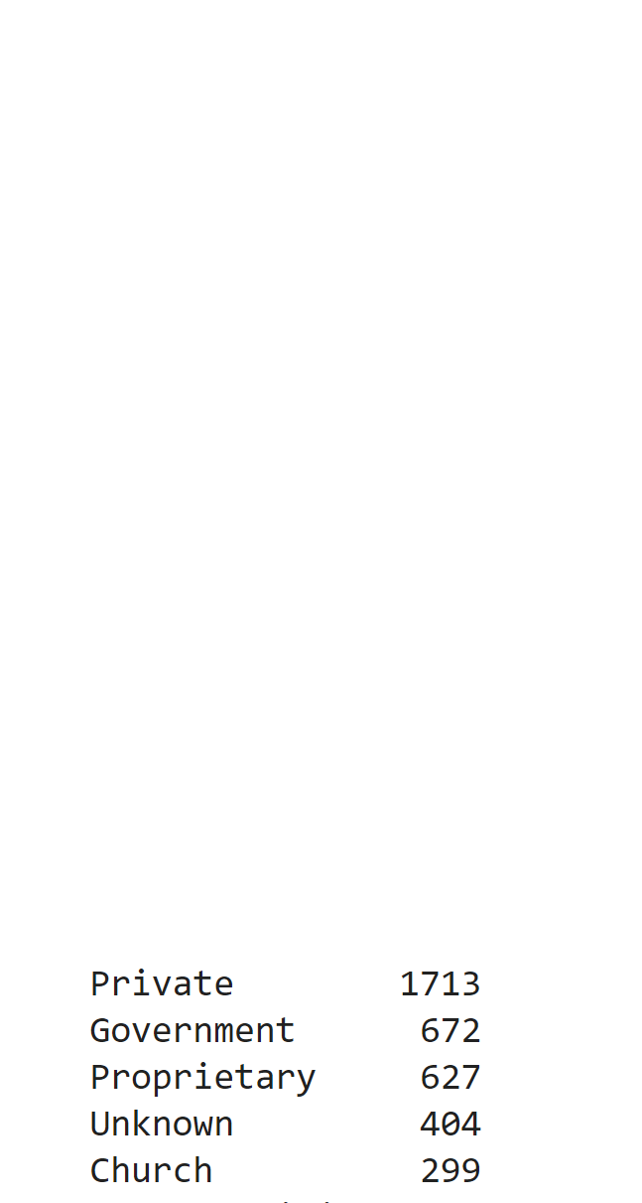
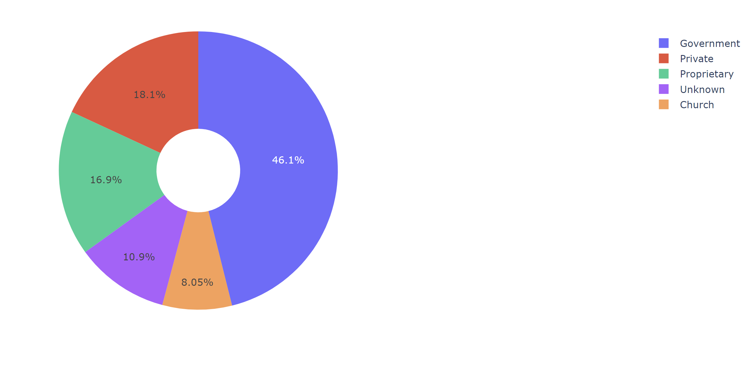
Percentage of Hospitals by Facility Type

Slide 5
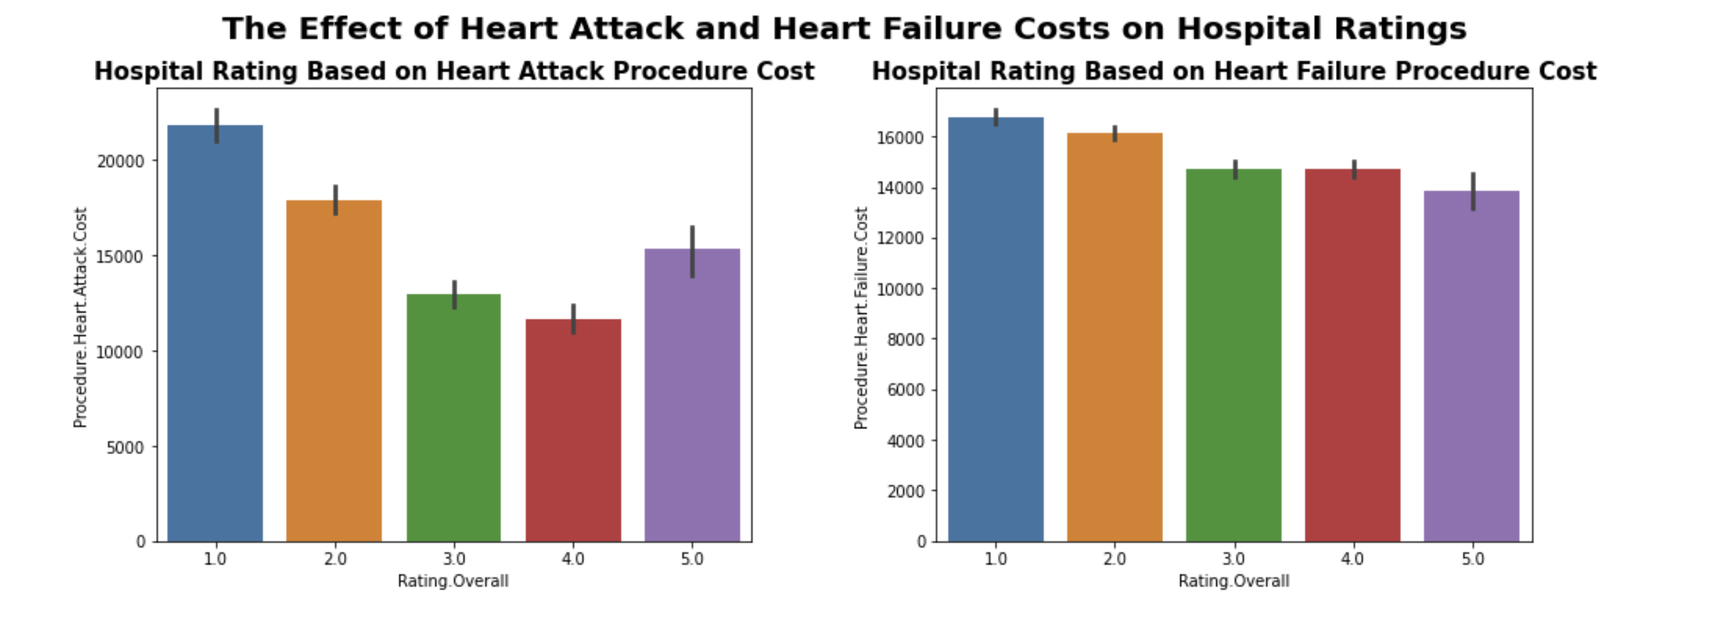
Heart Attack and Heart Failure Costs by Rating

Slide 6
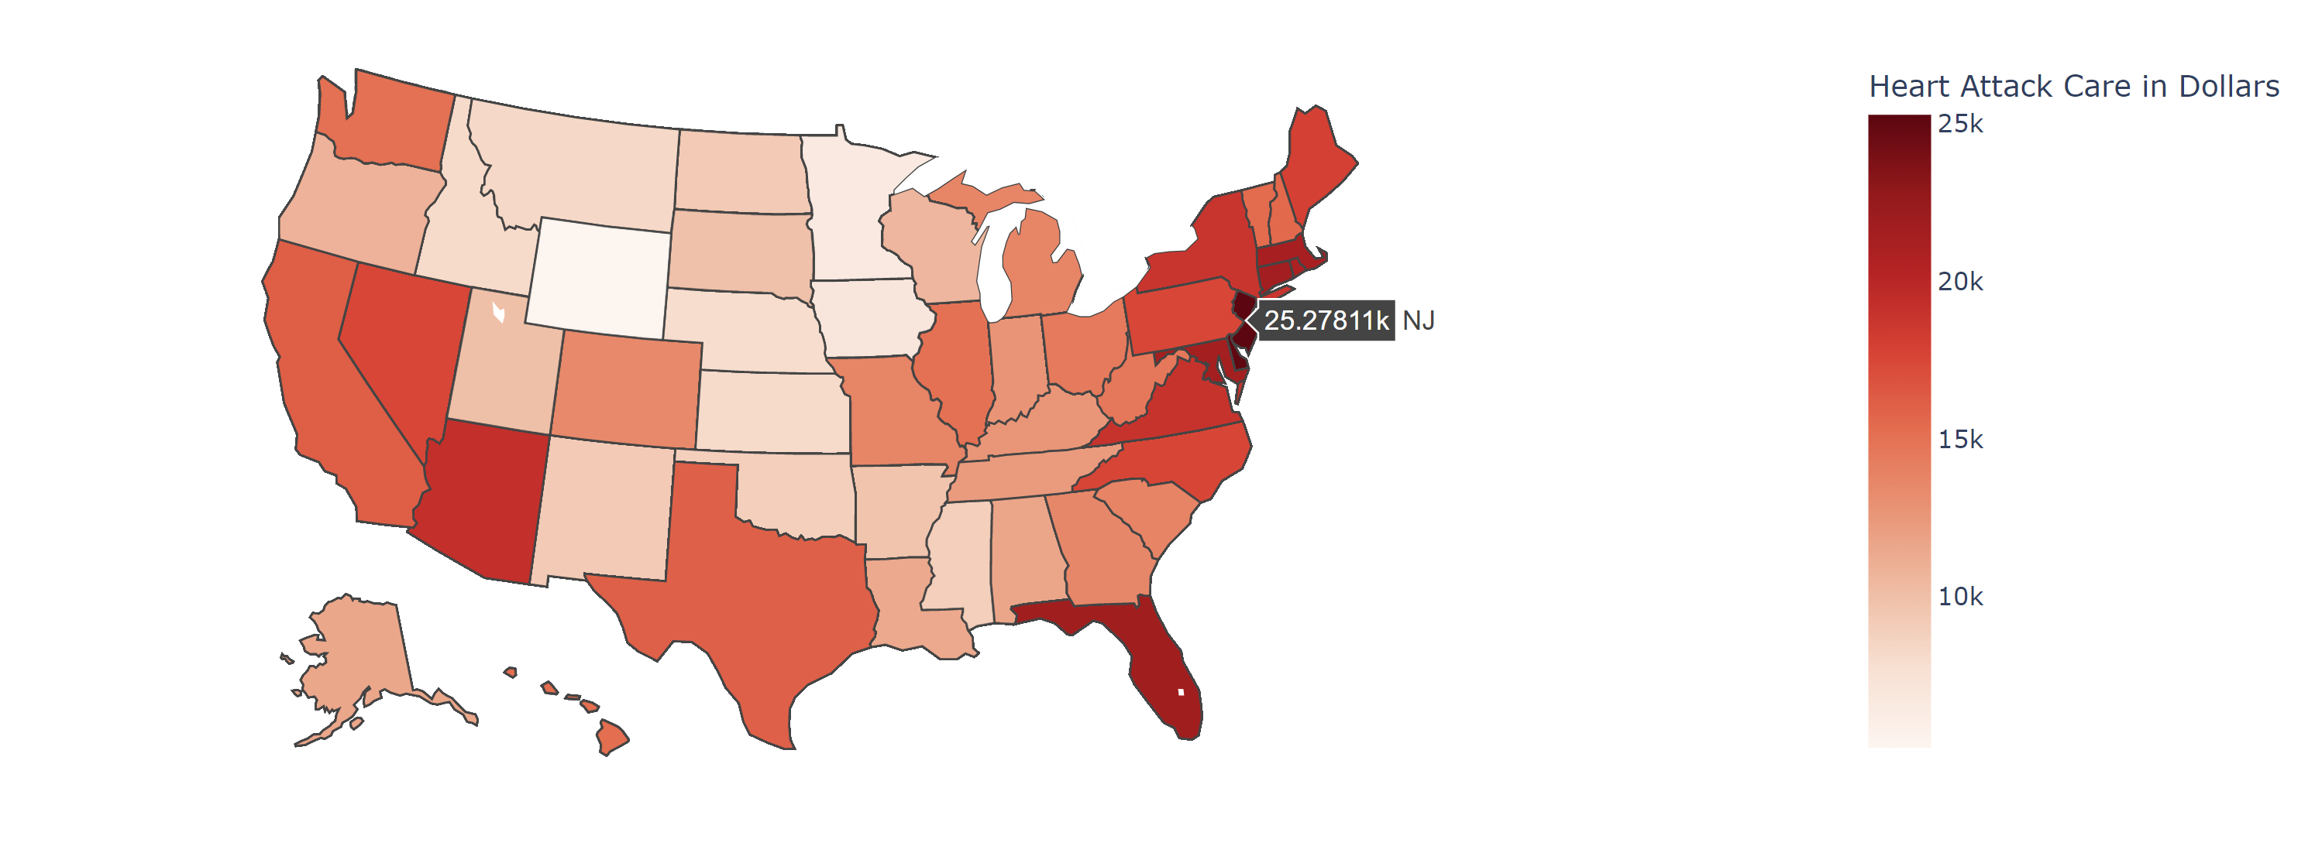
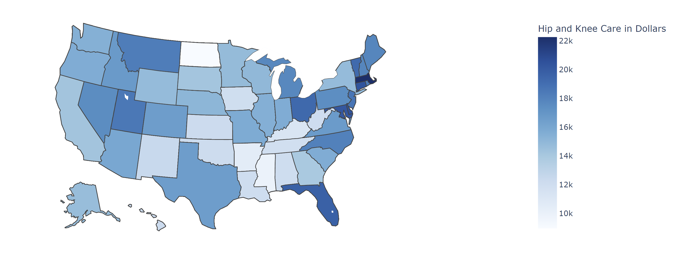
Average Cost of Heart Attack Care by State
Average Cost of Hip and Knee Care by State

Slide 7
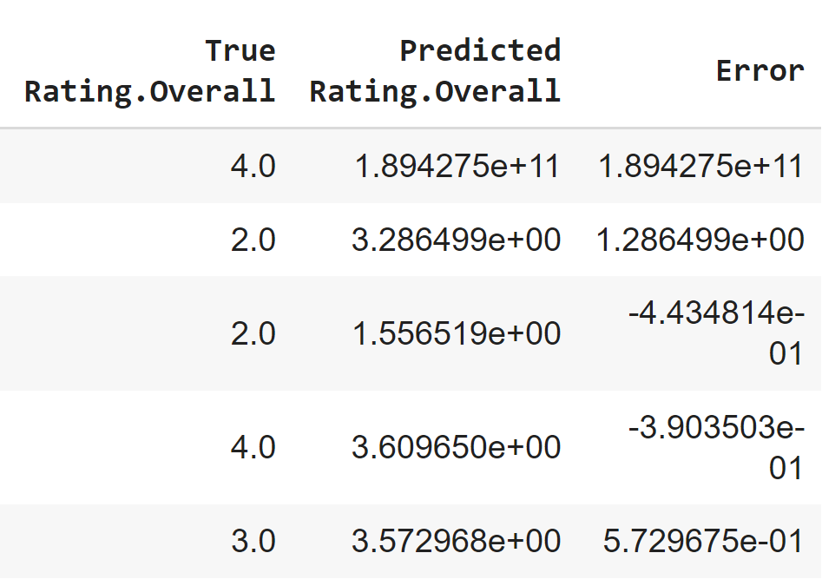
Model and Evaluation
KNN Model with best k
Improved to 42% test accuracy with best k value of 15
Sequential deep learning model led to high bias and underfitting
Need more data
Need more correlated features
Metrics low for training and testing sets across models
Do not recommend model for implementation
Predicting target with linear regression
model before tuning

Slide 8
Limitations
Over 6,000 hospitals nationally.
Data contains 3,715 hospitals
Data collected works for qualitative comparisons.
Features are not strongly correlated to target.

Slide 9
Importance of Continuing to Gather Hospital Data
Increases availability and accessibility of information.
Improves patient engagement.
Quality, utilization and costs
Improving engagement can in turn encourage patient adherence and effective, informed decision-making.
Increased demand for healthcare resources will create a need for more and continued health services nationally.

